Slide 1
The church-home partnership Gareth Crispin Youth Children & Families Minister St. John’s Lindow.

Slide 2
What’s I’m assuming
That we all want youth and children to become disciples of Christ;

Slide 3
What’s I’m assuming
That we all want youth and children to become disciples of Christ;
That we all think that peer groups, family and the wider church are important in this.

Slide 4
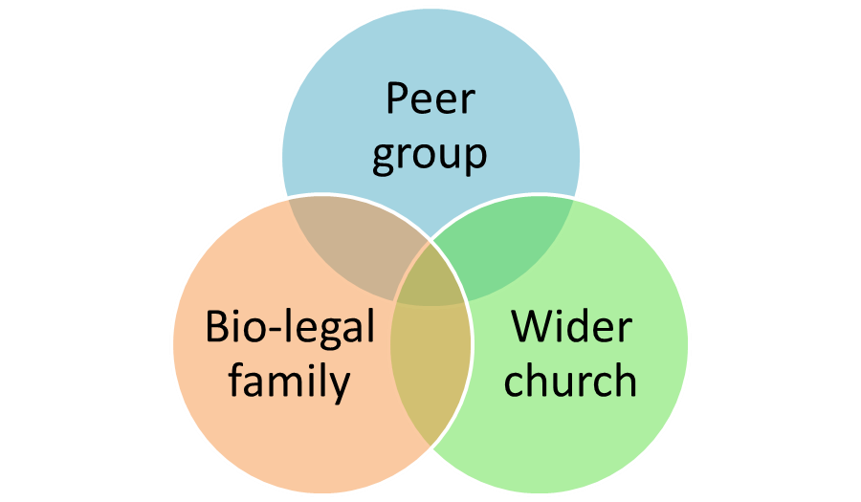

Slide 5
A problem
Y&C
Church

Slide 7
A problem
Secularisation (Fragmentation in society)
Consumerism (now extended to identity)
Professionalization (trust the expert and the systems)

Slide 8
Solution?
Bring things back to the family (Family Ministry)
Deuteronomy 6:4-6 & Ephesians 6:4
Integrate the Y&C into ‘the church’ (integration or Intergenerational church)
Mark 3:31-34, the context of Deuteronomy and the doctrine of adoption and Fatherhood of God.

Slide 9
Describing the relationship
Family Ministry
“The process of intentionally and persistently coordinating a ministry’s proclamation and practices so that parents are acknowledged, trained and held accountable as primary disciple-makers in their children’s lives.”
Jones
Intergenerational Church
“When a congregation intentionally brings the generations together in mutual serving, sharing or learning within the core activities of the church in order to live out being the body of Christ to each other and the greater community."
Allen & Ross

Slide 10
Describing the relationship
Family Ministry
It takes parents (a father) to raise a child
Intergenerational Church
It take a church to raise a child

Slide 11
Describing the relationship
Need to avoid going completely one way or the other in a way that does not do justice to the Biblical witness

Slide 12
Describing the relationship
If it’s not one or the other then how do we connect the two?

Slide 13
Describing the relationship
Recognise that:
biological and legal families area creation ordinance and blessing;
Church is a redemption ordinance and blessing;

Slide 14
Salvation history
Creation
Re-creation
Fall
Redemption

Slide 15
100
Church
Primacy in discipleship
Family
0
Adult
Time/age

Slide 16
Describing the relationship
Aim of biological/legal guardians is not merely to disciple Y&C into the faith (universal church), but into the church (local church with discipling /shepherding at its heart);

Slide 17
Describing the relationship
Aim of biological/legal guardians is not merely to disciple Y&C into the faith, but into the church;
Almost like handing over pastoral responsibility.

Slide 18
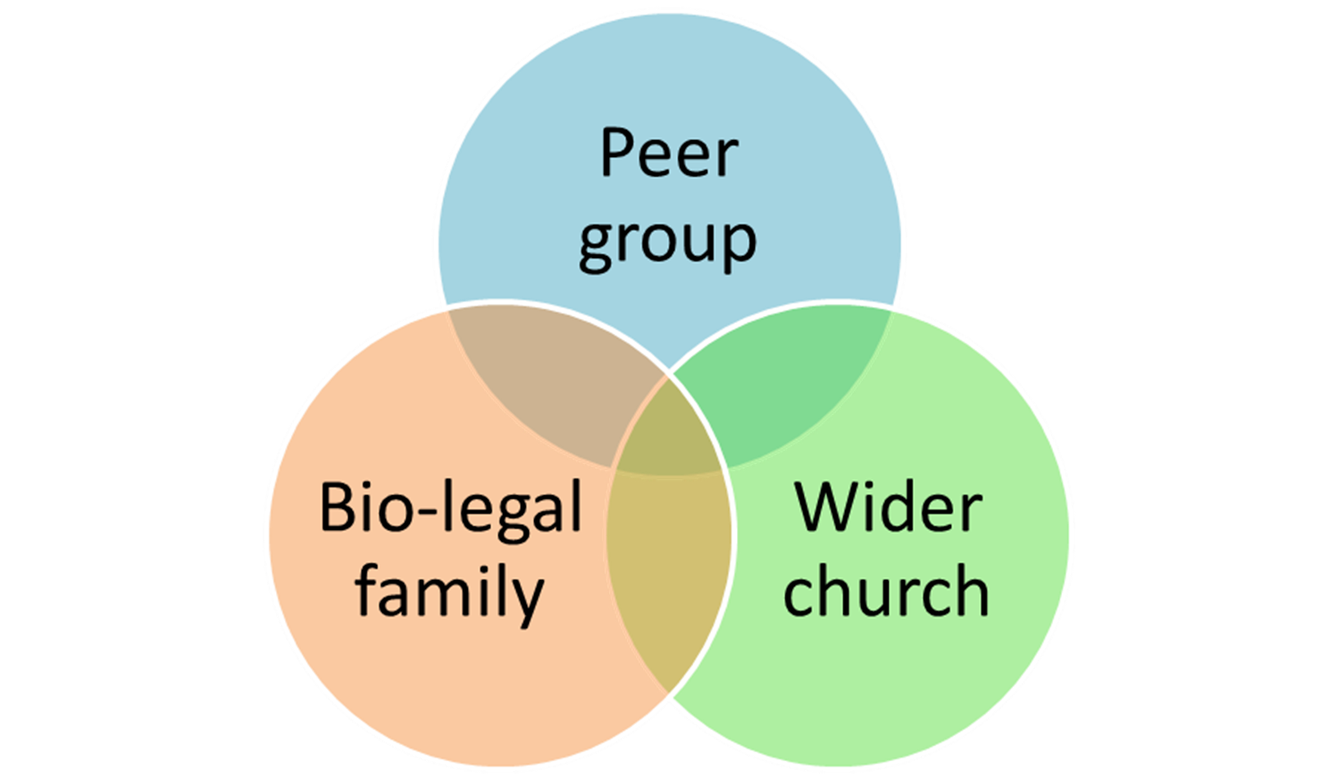
Before getting practical see this as a mind set a way of seeing

Slide 19
If these are important how can we partner together well?

Slide 20
Partnering in support of the bio-legal family?
?

Slide 21
Partnering in support of the bio-legal family
Disciple them in Christ; Love them; Pray for them
Support marriage (courses, books pastoral visiting, preaching, don’t overload parents!);
Good examples to young people before they get married and have children;
Bigging up baptism (= corporate commitment)
Parenting courses (before birth!), parenting as topic in pastoral visiting, preaching on parenting (in application and directly), parent mentors (older couples who are a few years down the line);
Family Worship resources, seminars etc.;
Communication on what is happening in Y&C’s groups;
General practical help (esp in the early years)
Help them understand the culture of Y&C;
Encourage parents with examples of what their Y&C have said/done;
Don’t provide so many Y&C events that there is no room for family events or even family life!
Don’t allow anti-parental attitudes in youth group
Teach on Family, marriage and parenting to the youth group

Slide 22
Partnering in support of the wider church
?

Slide 23
Partnering in support of the wider church
Pray for the wider church and the church leaders;
Train church leaders in Y&C ministry;
Prepare the family for worship
Don’t allow/foster anti-church attitudes in the home or Y&C groups;
Find out what is going on in Y&C groups and talk about it at home;
Teach about the church in the home (our family, brothers and sisters etc.)
Present church gatherings as central rather than a consumer choice;
Intentionally foster relationships between Y&C (build the peer group) and Y&C and older adults in the wider church;
Don’t work so hard at Y&C groups that they naturally emerge as separate entities (e.g. branding and advertising and strategy);
Families encouraging other families in support of wider church.

Slide 24
Partnering in support of the wider church
?

Slide 25
Partnering in support of the peer groups
Pray for the Y&C group leaders;
Train Y&C group leaders;
Volunteer for Y&C groups;
Don’t allow/foster anti-Y&C group attitudes in the home or wider church;
Present Y&C groups as central rather than a consumer choice;
Encourage other families to support Y&C groups (invites, lifts, good comments etc.)

Slide 26
Other things a church might do that might help the partnership
Teach same thing in Y&C groups on Sunday
Work at clean formal communication
Think carefully before presenting a menu of services;
Prepare them at each step for inclusion in wider church (e.g. transition group for move out of Sunday groups);
Accommodate them into church – make it accessible they are the weaker brother/sister. e.g. style and applications in preaching, how we go about communion, singing etc.
Mark transitions (e.g. year 6-7; school leavers)?
Family Forums

Slide 27
Other things a church might do that might help the partnership

Slide 28
Implementation?
Get parents, youth leaders and Vicars together;
Talk about the mind set;
Talk about which things you’d like to change (this may mean stopping other things);
Talk about how to communicate that and how quickly to do it and what concerns some people may have;
Talk about what issues will need to be addressed.

Slide 29
Resources
Engaging parents as Allies (Wayne Rice, 2009);
Family Ministry Field Guide – How your church can equip parents to make disciples (Timothy Paul Jones, 2011)
Men the Gap – Can the Church reconnect the generations (Jason Gardner, 2008)
Sticky Faith – Everyday ideas to build lasting faith in your kids – Kara Powell & Chap Clark, 2011)

